Slide 1
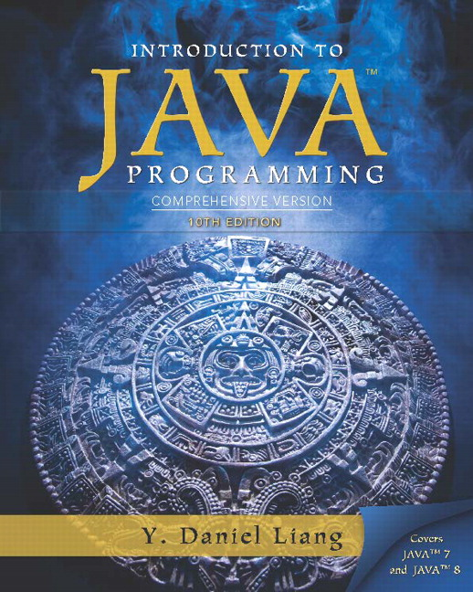
Introduction to Java Programming Comprehensive Version
Tenth Edition
Chapter 7
Single-Dimensional Arrays
Slides in the presentation contain hyperlinks. J A W S users should be able to get a list of links by using INSERT+F7
Copyright © 2015 Pearson Education, Inc. All Rights Reserved
Notes:
If this PowerPoint presentation contains mathematical equations, you may need to check that your computer has the following installed:
1) MathType Plugin
2) Math Player (free versions available)
3) NVDA Reader (free versions available)

Slide 2
Opening Problem
Read one hundred numbers, compute their average, and find out how many numbers are above the average.

Slide 3
Objectives (1 of 3)
7.1 To describe why arrays are necessary in programming (§7.1).
7.2 To declare array reference variables and create arrays (§7.2.1-7.2.2).
7.3 To obtain array size using arrayRefVar.length and know default values in an array (§7.2.3).
7.4 To access array elements using indexes (§7.2.4).
7.5 To declare, create, and initialize an array using an array initializer (§7.2.5).

Slide 4
Objectives (2 of 3)
7.6 To program common array operations (displaying arrays, summing all elements, finding the minimum and maximum elements, random shuffling, and shifting elements) (§7.2.6).
7.7 To simplify programming using the foreach loops (§7.2.7).
7.8 To apply arrays in application development (AnalyzeNumbers, DeckOfCards) (§7.3-7.4).
7.9 To copy contents from one array to another (§7.5).
7.10 To develop and invoke methods with array arguments and return values (§§7.6-7.8).

Slide 5
Objectives (3 of 3)
7.11 To define a method with a variable-length argument list (§7.9).
7.12 To search elements using the linear (§7.10.1) or binary (§7.10.2) search algorithm.
7.13 To sort an array using the selection sort approach (§7.11).
7.14 To use the methods in the java.util.Arrays class (§7.12).
7.15 To pass arguments to the main method from the command line (§7.13).

Slide 6
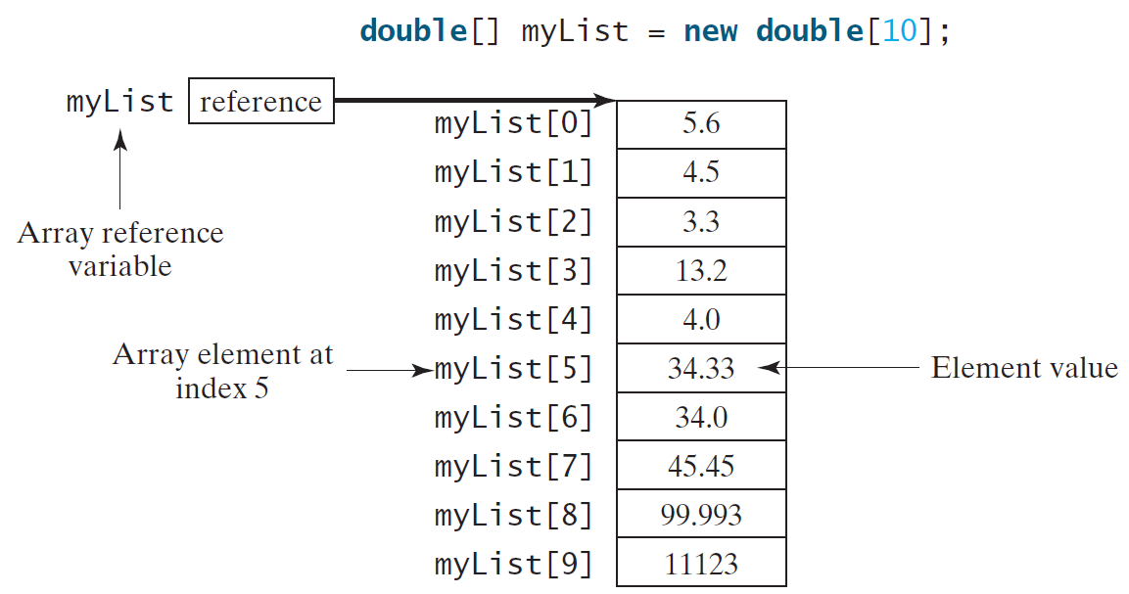
Introducing Arrays
Array is a data structure that represents a collection of the same types of data.

Slide 7
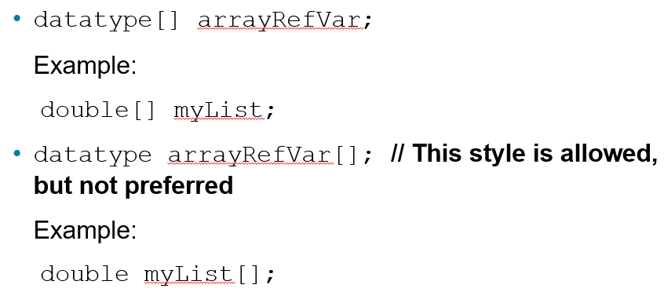
Declaring Array Variables

Slide 8
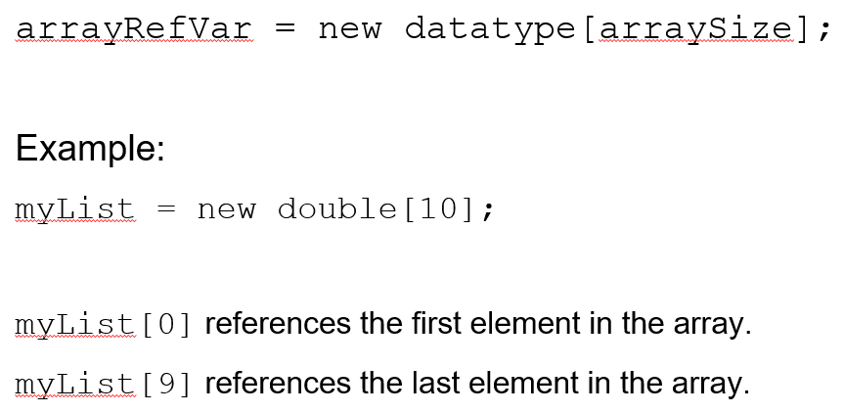
Creating Arrays

Slide 9
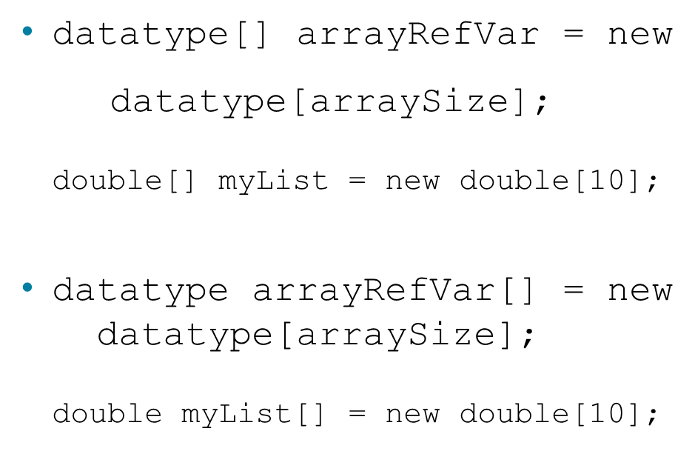
Declaring and Creating in One Step

Slide 10
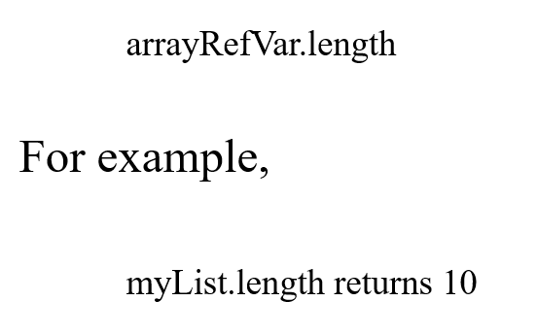
The Length of an Array
Once an array is created, its size is fixed. It cannot be changed. You can find its size using

Slide 11
Default Values
When an array is created, its elements are assigned the default value of
0 for the numeric primitive data types,
‘\u0000’ for char types, and
false for boolean types.

Slide 12
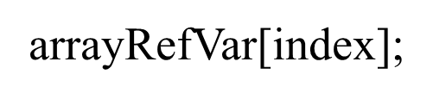
Indexed Variables
The array elements are accessed through the index. The array indices are 0-based, i.e., it starts from 0 to arrayRefVar.length-1. In the example in Figure 6.1, myList holds ten double values and the indices are from 0 to 9.
Each element in the array is represented using the following syntax, known as an indexed variable:

Slide 13
Using Indexed Variables
After an array is created, an indexed variable can be used in the same way as a regular variable. For example, the following code adds the value in myList[0] and myList[1] to myList[2].

Slide 14
Array Initializers
Declaring, creating, initializing in one step:
This shorthand syntax must be in one statement.

Slide 15
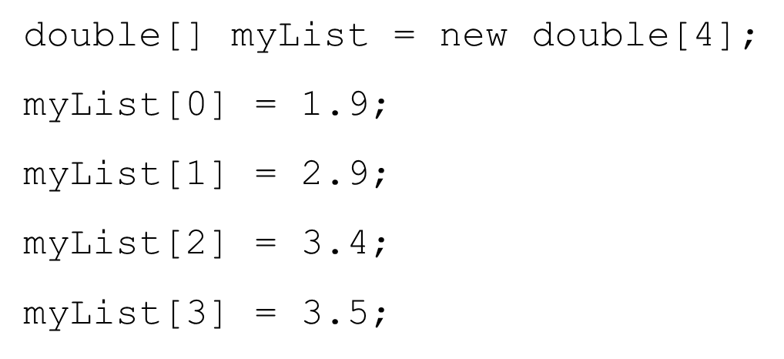
Declaring, creating, initializing Using the Shorthand Notation
This shorthand notation is equivalent to the following statements:

Slide 16
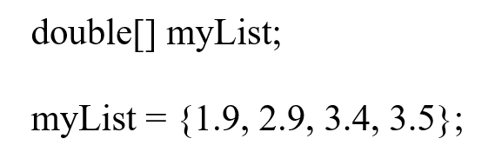
Caution
Using the shorthand notation, you have to declare, create, and initialize the array all in one statement. Splitting it would cause a syntax error. For example, the following is wrong:

Slide 17
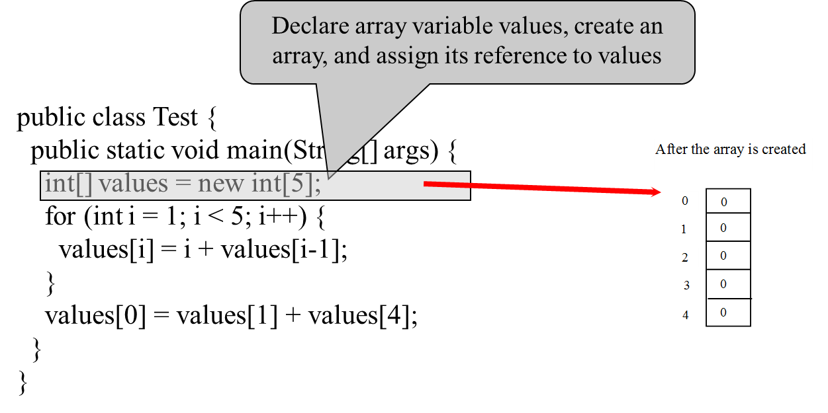
Trace Program with Arrays (1 of 16)

Slide 18
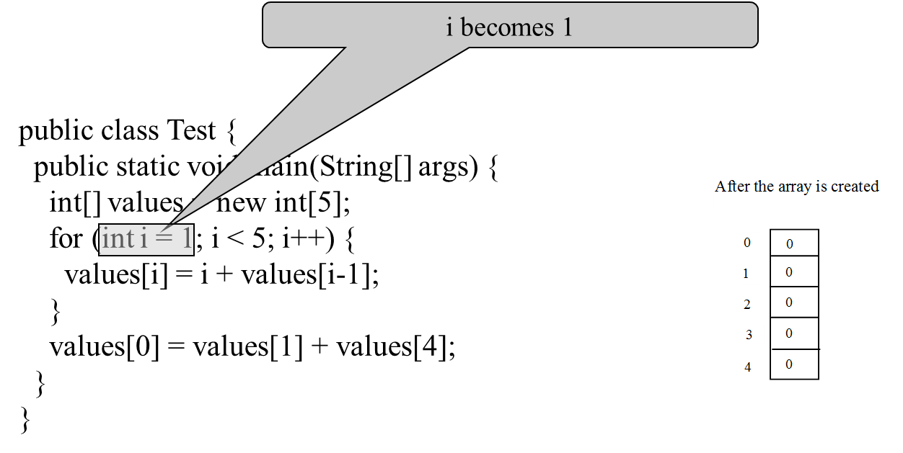
Trace Program with Arrays (2 of 16)

Slide 19
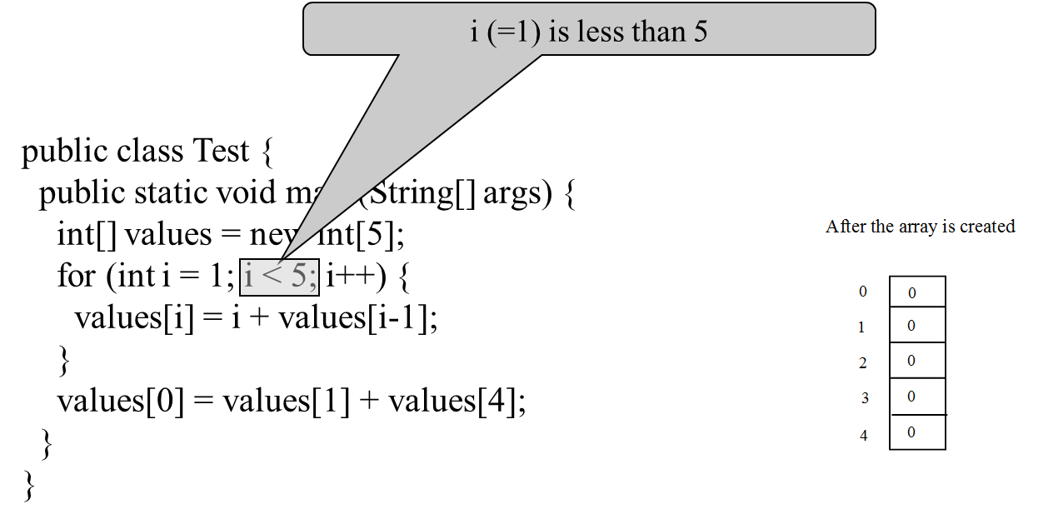
Trace Program with Arrays (3 of 16)

Slide 20
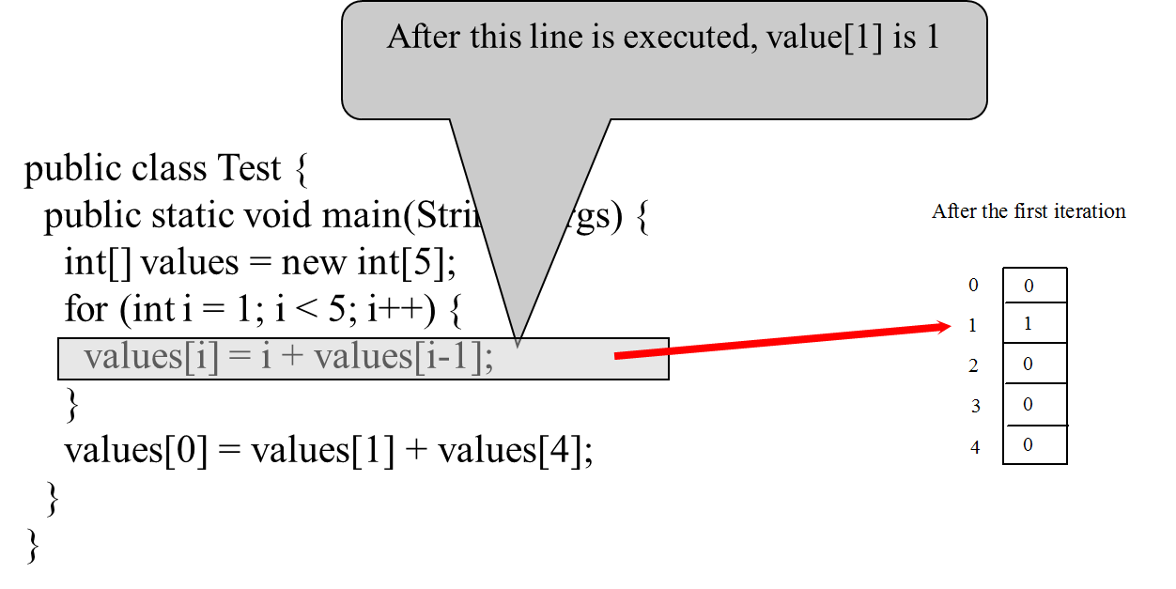
Trace Program with Arrays (4 of 16)

Slide 21
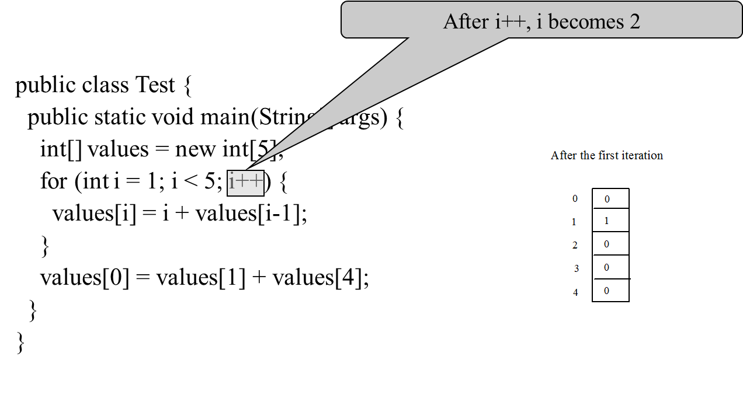
Trace Program with Arrays (5 of 16)

Slide 22
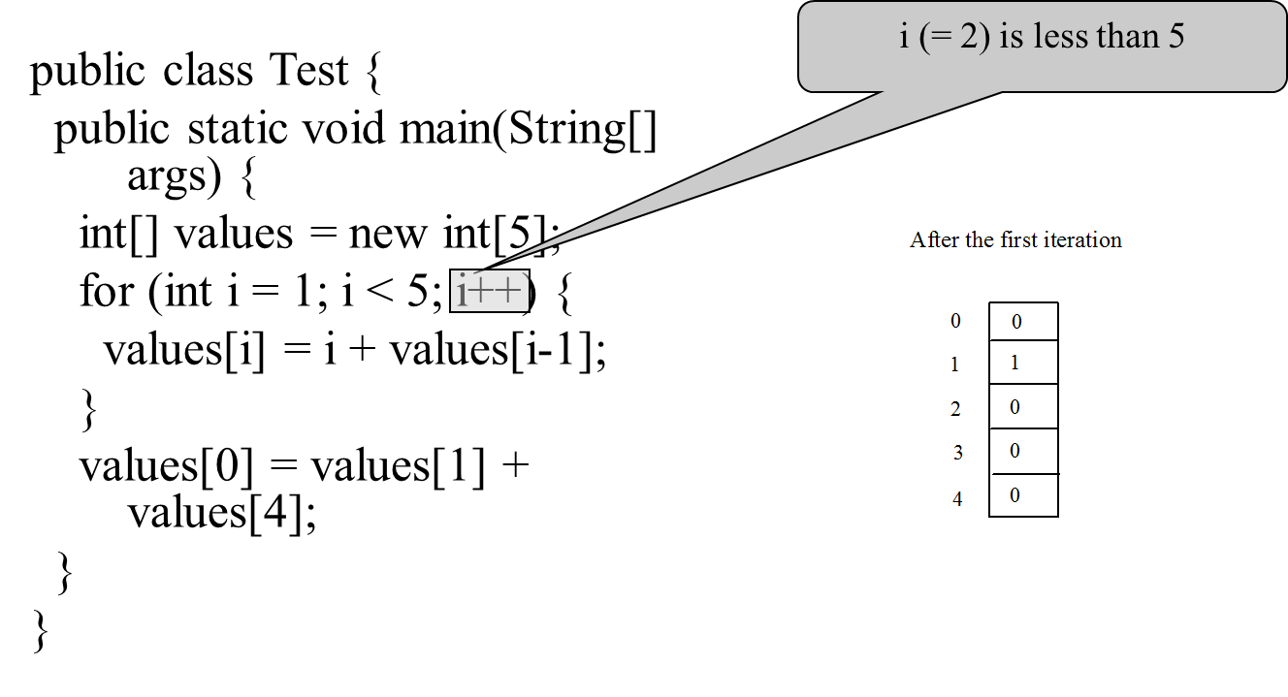
Trace Program with Arrays (6 of 16)

Slide 23
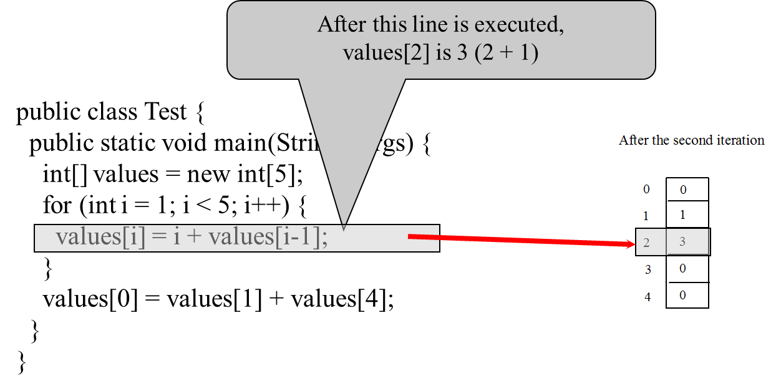
Trace Program with Arrays (7 of 16)

Slide 24
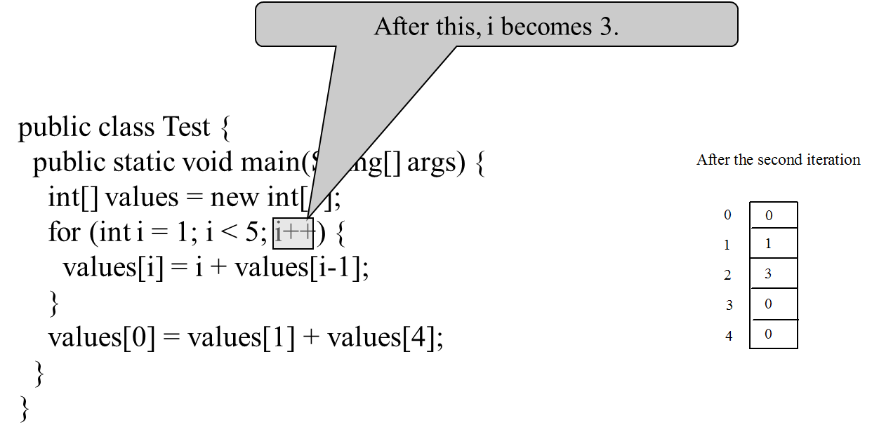
Trace Program with Arrays (8 of 16)

Slide 25
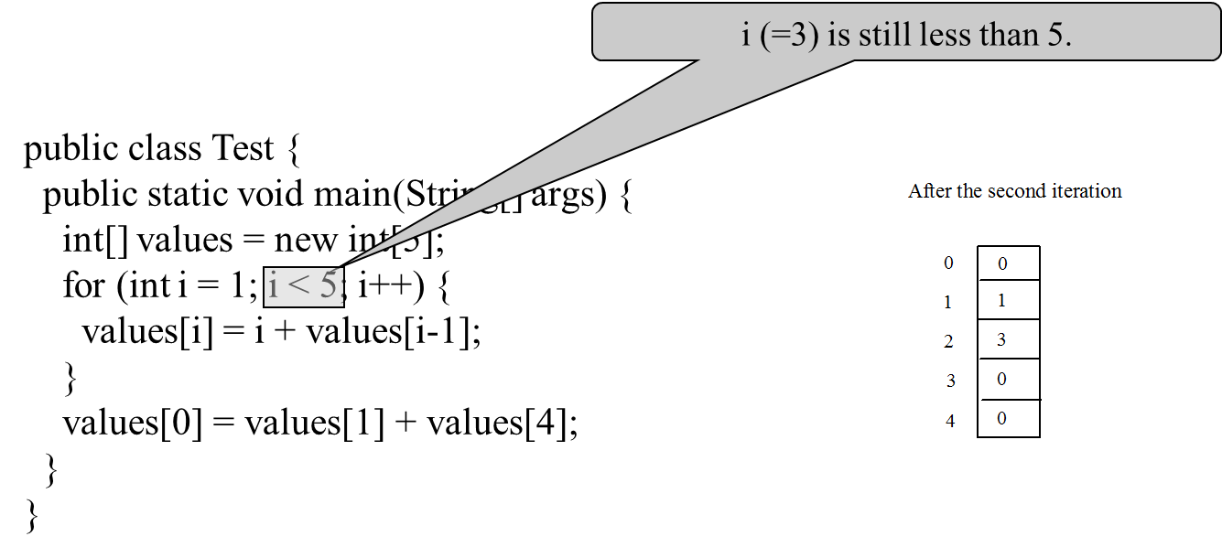
Trace Program with Arrays (9 of 16)

Slide 26
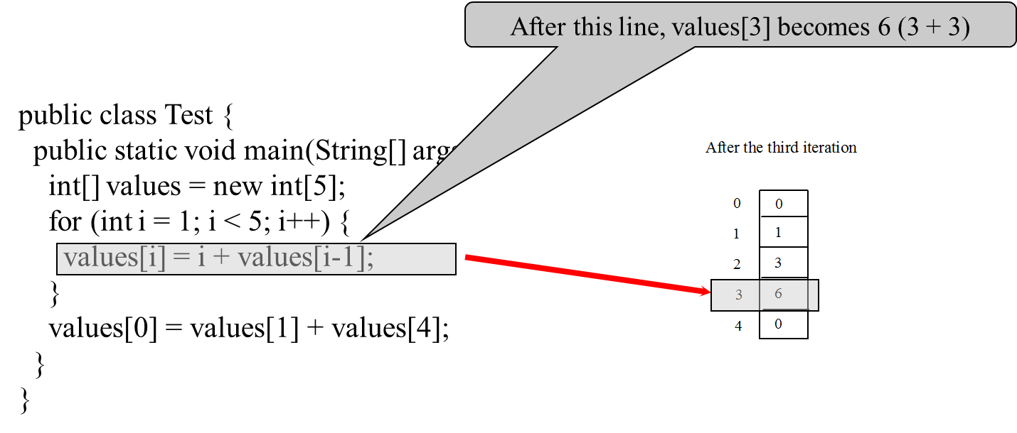
Trace Program with Arrays (10 of 16)

Slide 27
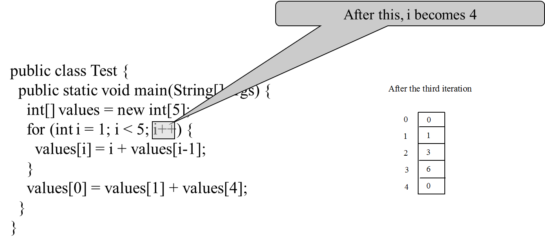
Trace Program with Arrays (11 of 16)

Slide 28
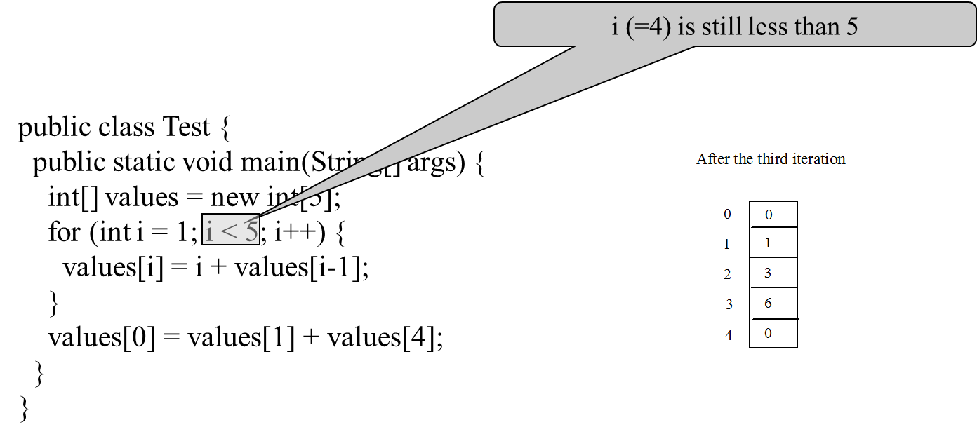
Trace Program with Arrays (12 of 16)

Slide 29
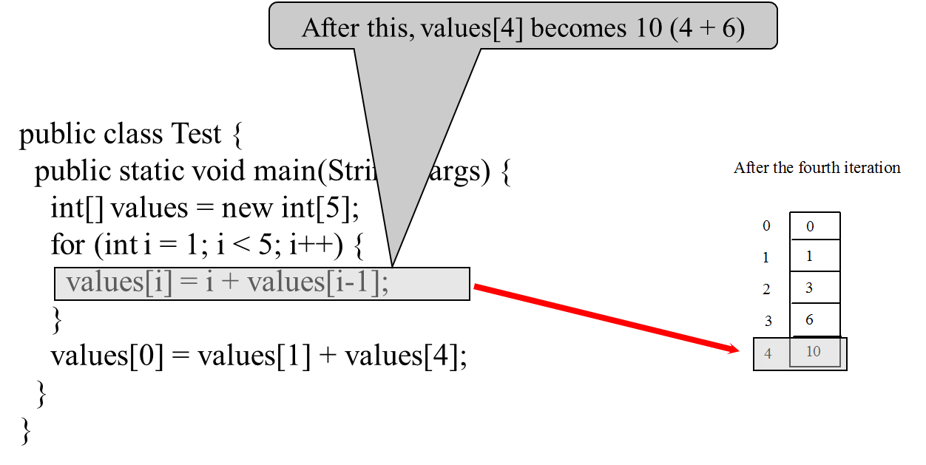
Trace Program with Arrays (13 of 16)

Slide 30
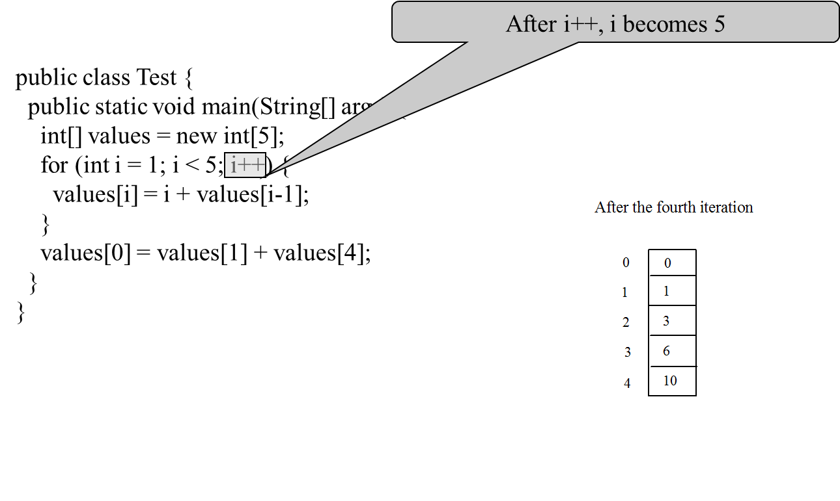
Trace Program with Arrays (14 of 16)

Slide 31
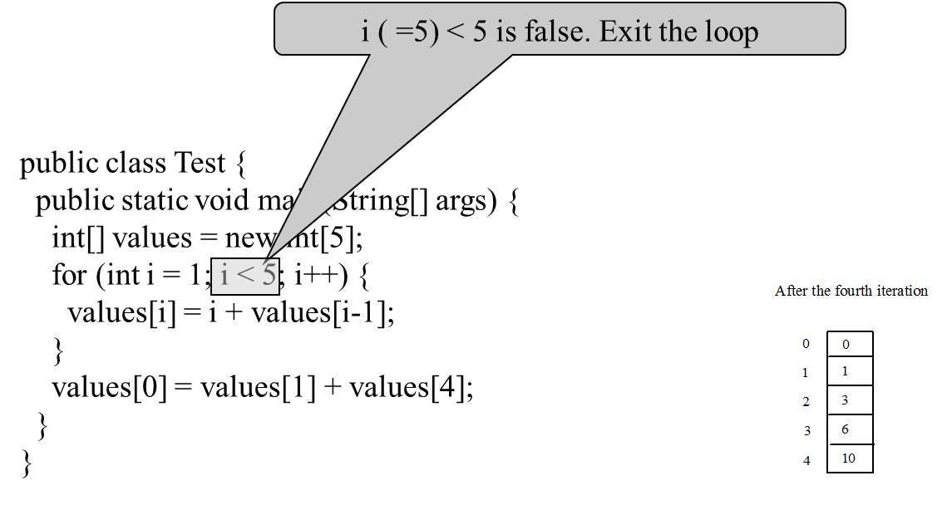
Trace Program with Arrays (15 of 16)

Slide 32
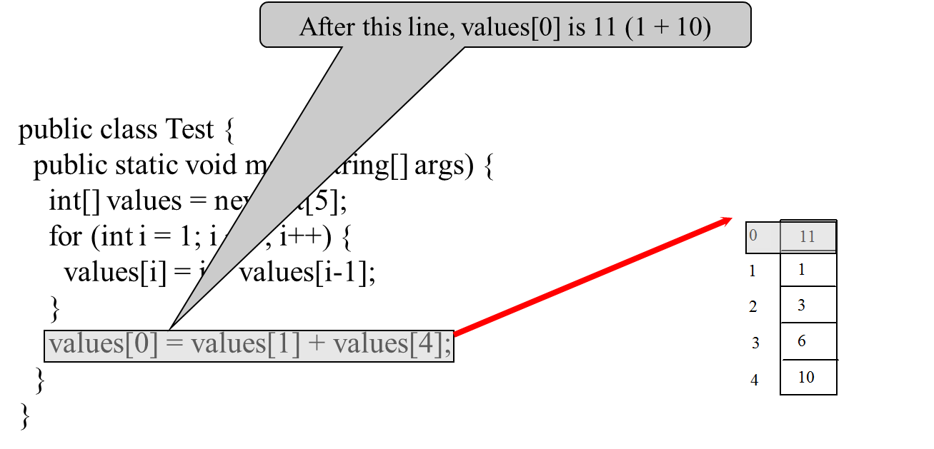
Trace Program with Arrays (16 of 16)

Slide 33
Processing Arrays
See the examples in the text.
(Initializing arrays with input values)
(Initializing arrays with random values)
(Printing arrays)
(Summing all elements)
(Finding the largest element)
(Finding the smallest index of the largest element)
(Random shuffling)
(Shifting elements)

Slide 34
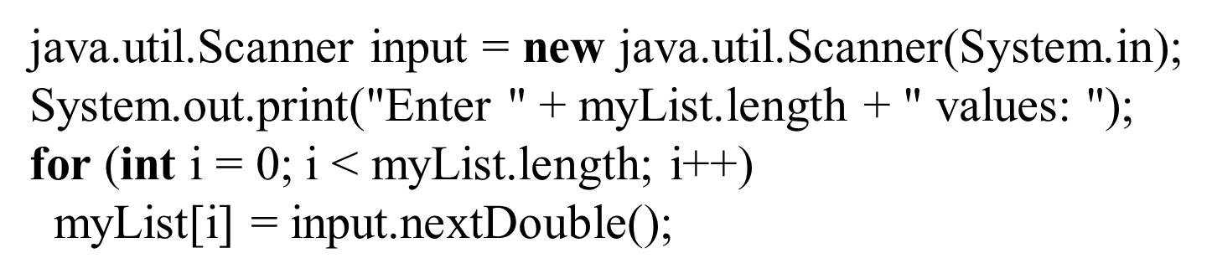
Initializing arrays with input values

Slide 35
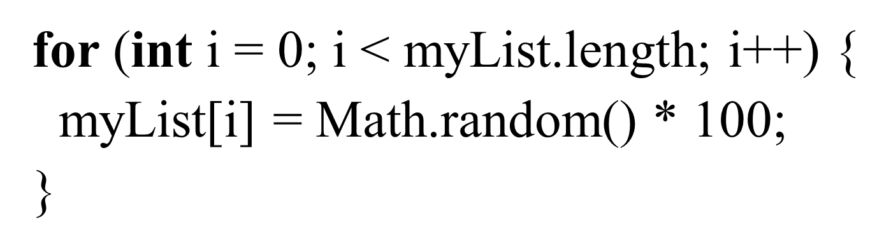
Initializing arrays with random values

Slide 36
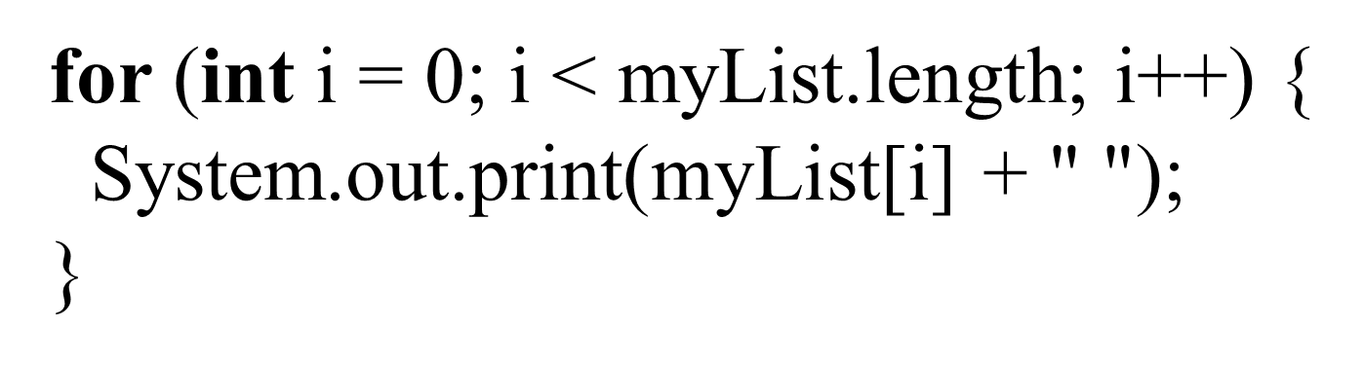
Printing arrays

Slide 37
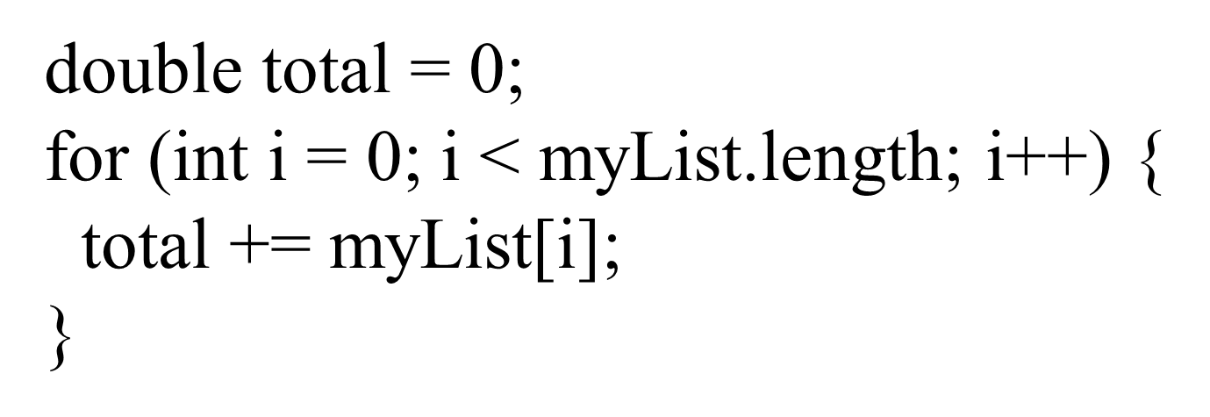
Summing all elements

Slide 38
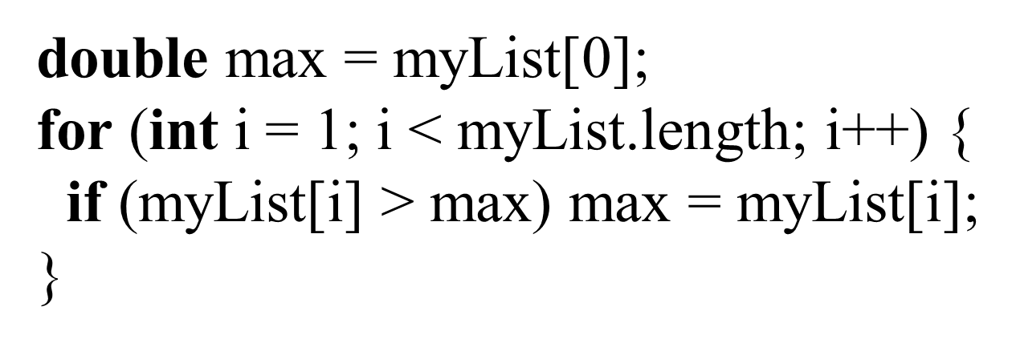
Finding the largest element

Slide 39
Random shuffling

Slide 40
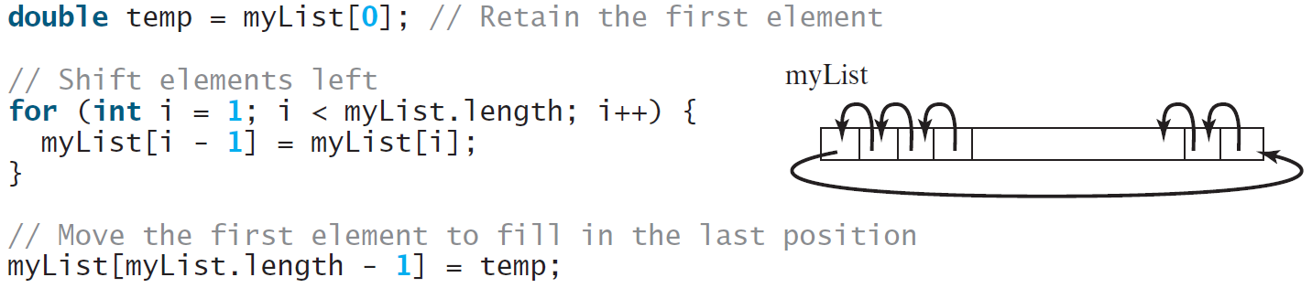
Shifting Elements

Slide 41
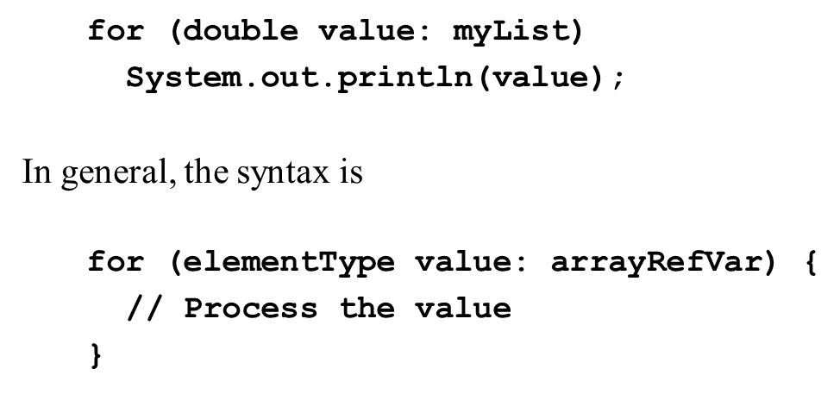
Enhanced for Loop (for-each loop)
JDK 1.5 introduced a new for loop that enables you to traverse the complete array sequentially without using an index variable. For example, the following code displays all elements in the array myList:
You still have to use an index variable if you wish to traverse the array in a different order or change the elements in the array.

Slide 42
Analyze Numbers
Read one hundred numbers, compute their average, and find out how many numbers are above the average.
AnalyzeNumbers
Run

Slide 43
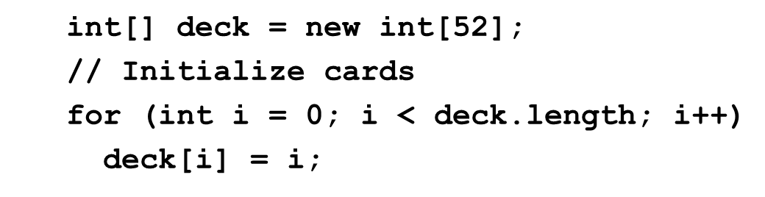
Problem: Deck of Cards (1 of 4)
The problem is to write a program that picks four cards randomly from a deck of 52 cards. All the cards can be represented using an array named deck, filled with initial values 0 to 51, as follows:
DeckOfCards
Run

Slide 44
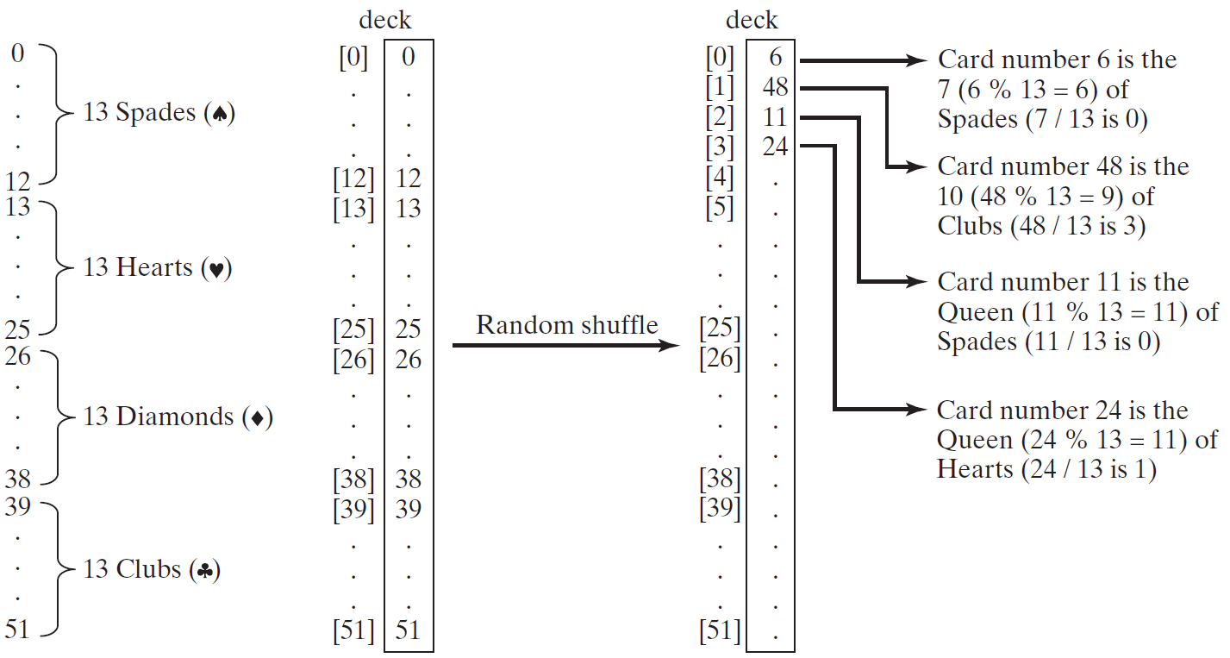
Problem: Deck of Cards (2 of 4)

Slide 45
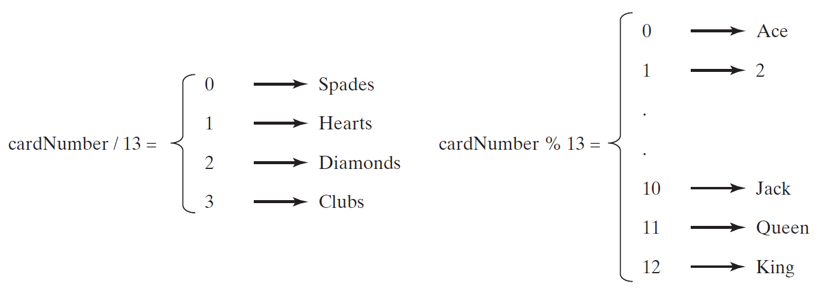
Problem: Deck of Cards (3 of 4)
GUI Demo (picking four cards)
DeckOfCards
Run

Slide 46
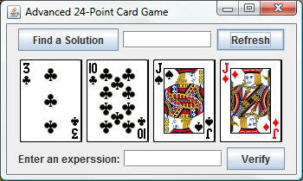
Problem: Deck of Cards (4 of 4)
This problem builds a foundation for future more interesting and realistic applications:
See Exercise 20.15. Click here to play 24-Point game
Run 24 Point Game

Slide 47
Problem: Lotto Numbers (1 of 2)
Suppose you play the Pick-10 lotto. Each ticket has 10 unique numbers ranging from 1 to 99. You buy a lot of tickets. You like to have your tickets to cover all numbers from 1 to 99. Write a program that reads the ticket numbers from a file and checks whether all numbers are covered. Assume the last number in the file is 0.
Lotto Numbers Sample Data
LottoNumbers
Run

Slide 48
Problem: Lotto Numbers (2 of 2)

Slide 49
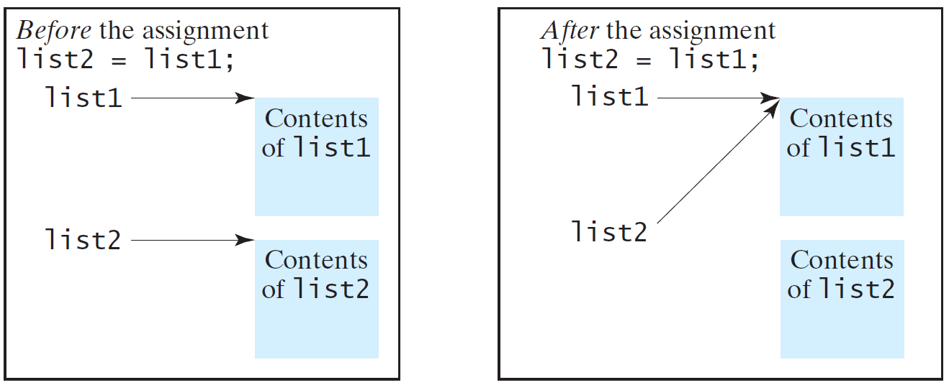
Copying Arrays (1 of 2)
Often, in a program, you need to duplicate an array or a part of an array. In such cases you could attempt to use the assignment statement (=), as follows:
list2 = list1;

Slide 50
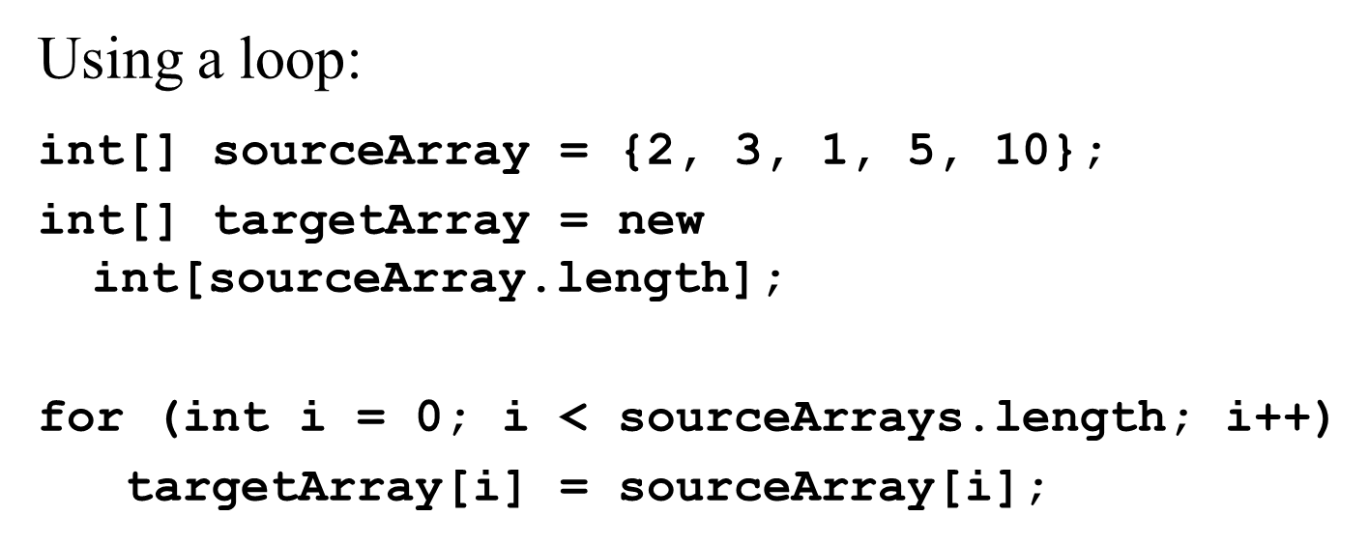
Copying Arrays (2 of 2)

Slide 51
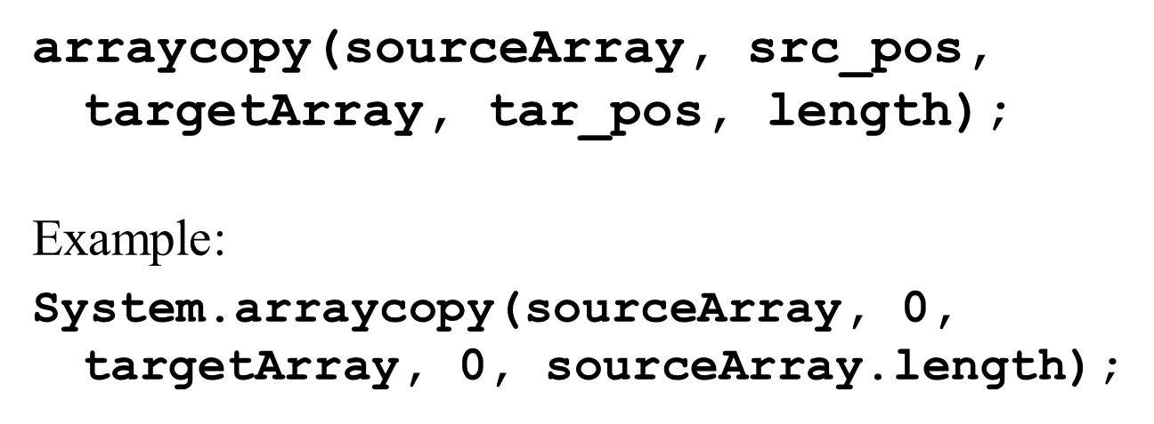
The arraycopy Utility

Slide 52
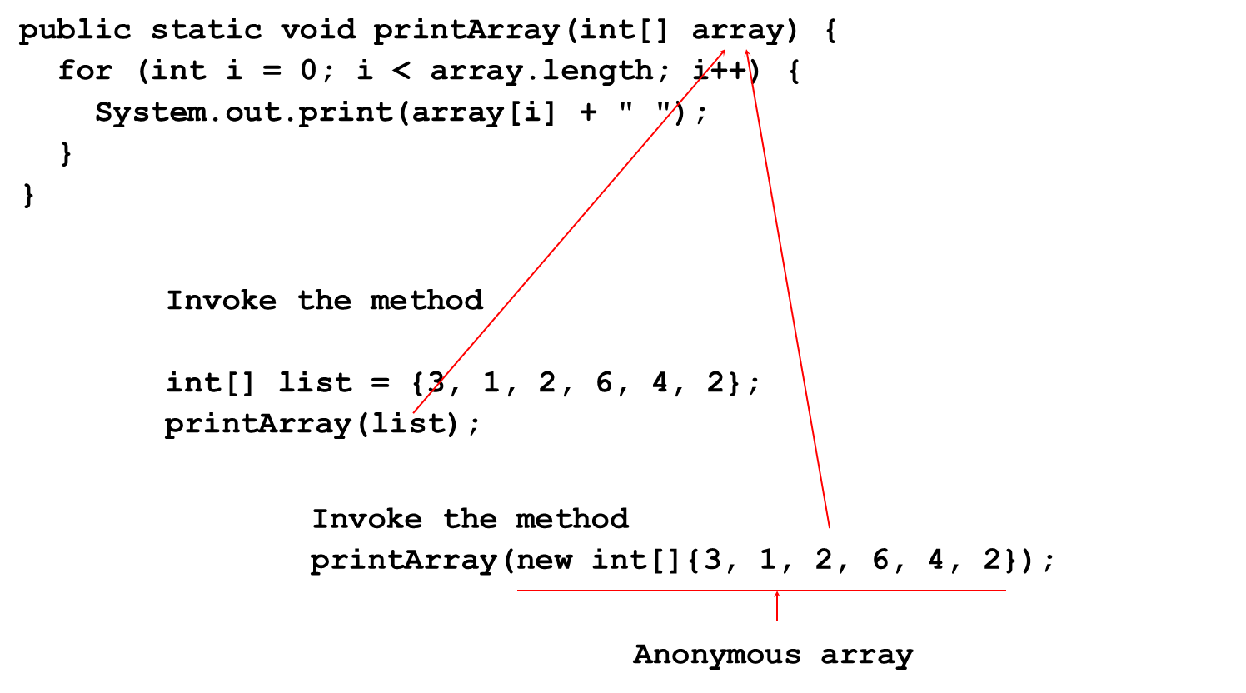
Passing Arrays to Methods

Slide 53
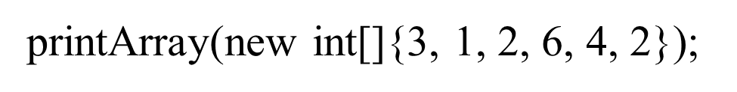
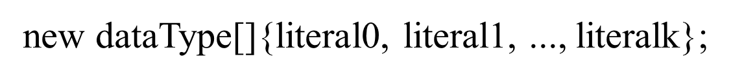
Anonymous Array (1 of 2)
The statement
creates an array using the following syntax:
creates an array using the following syntax:

Slide 54
Anonymous Array (2 of 2)
Java uses pass by value to pass arguments to a method. There are important differences between passing a value of variables of primitive data types and passing arrays.
For a parameter of a primitive type value, the actual value is passed. Changing the value of the local parameter inside the method does not affect the value of the variable outside the method.
For a parameter of an array type, the value of the parameter contains a reference to an array; this reference is passed to the method. Any changes to the array that occur inside the method body will affect the original array that was passed as the argument.

Slide 55
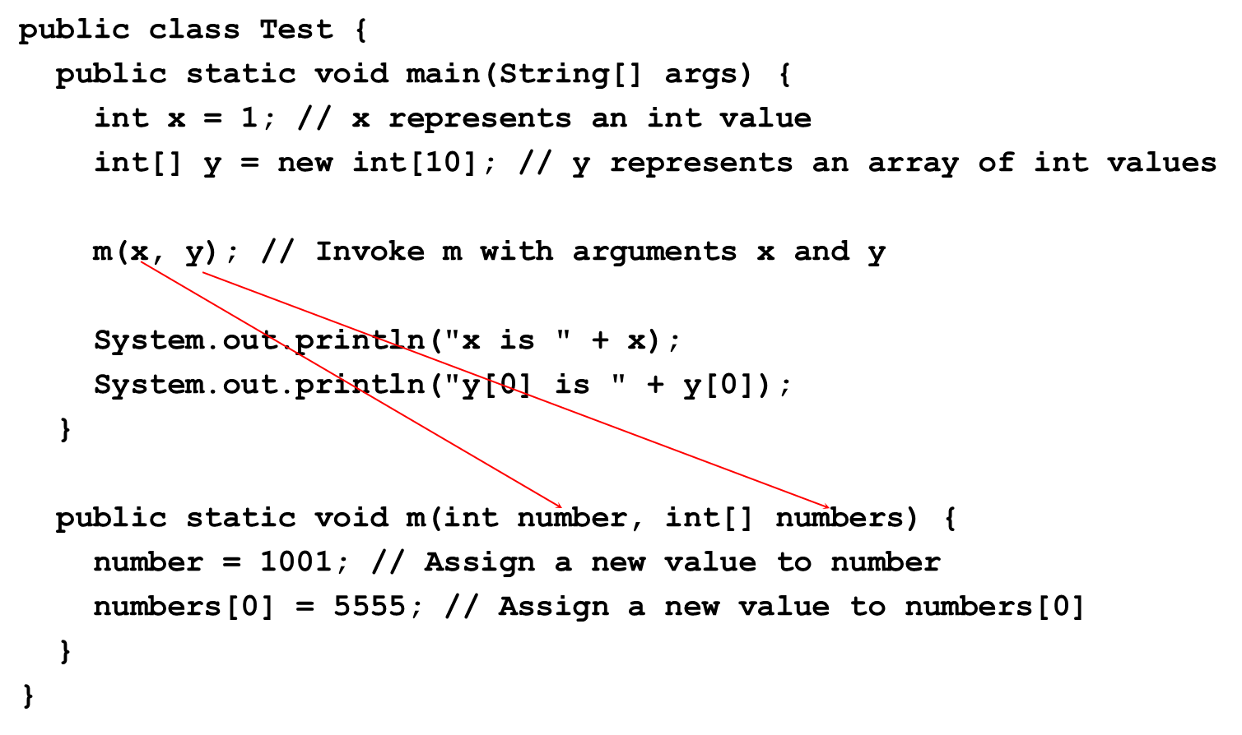
Simple Example

Slide 56
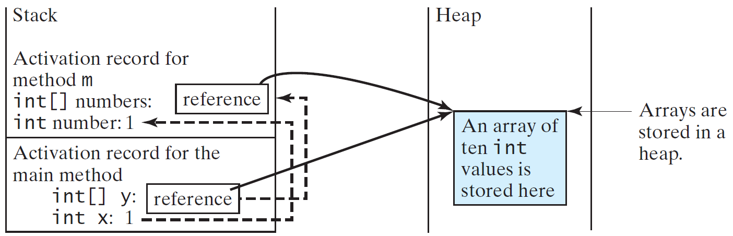
Call Stack (1 of 2)
When invoking m(x, y), the values of x and y are passed to number and numbers. Since y contains the reference value to the array, numbers now contains the same reference value to the same array.

Slide 57
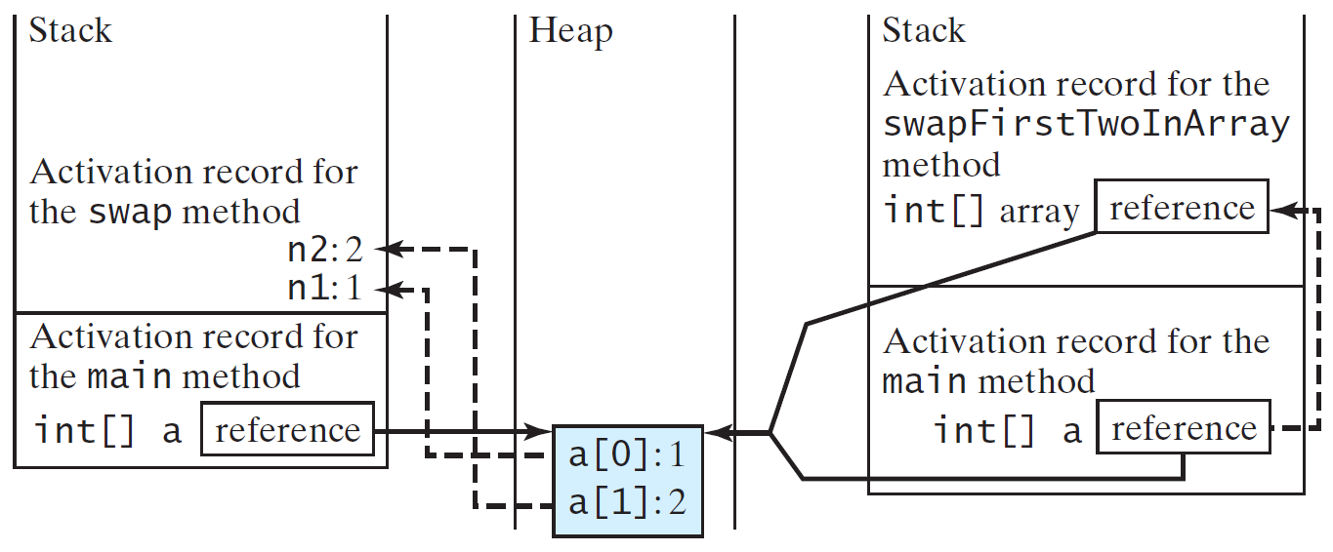
Call Stack (2 of 2)
When invoking m(x, y), the values of x and y are passed to number and numbers. Since y contains the reference value to the array, numbers now contains the same reference value to the same array.

Slide 58
Heap
The J V M stores the array in an area of memory, called heap, which is used for dynamic memory allocation where blocks of memory are allocated and freed in an arbitrary order.

Slide 59
Passing Arrays as Arguments
Objective: Demonstrate differences of passing primitive data type variables and array variables.
TestPassArray
Run

Slide 60
Example

Slide 61
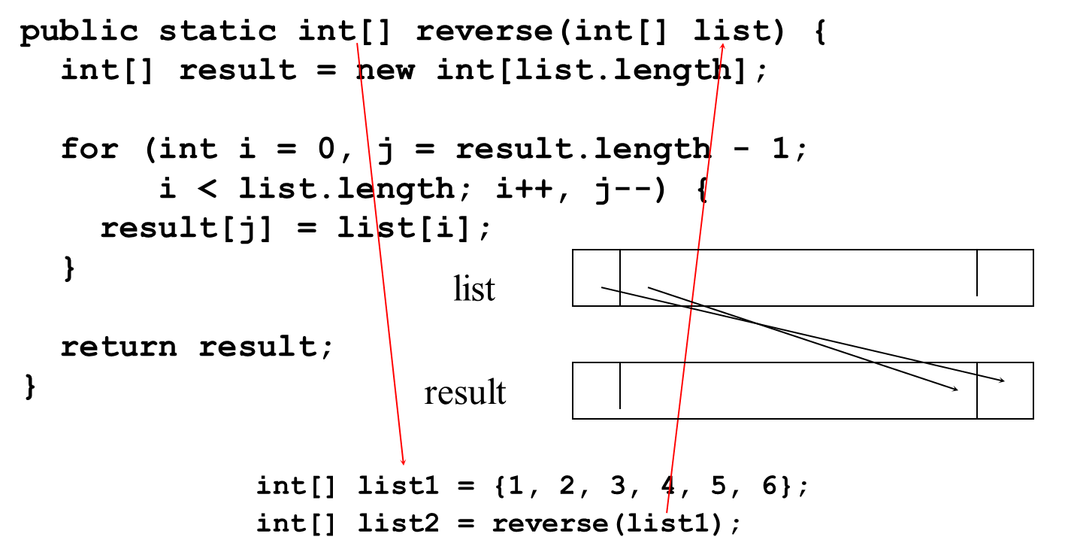
Returning an Array from a Method

Slide 62
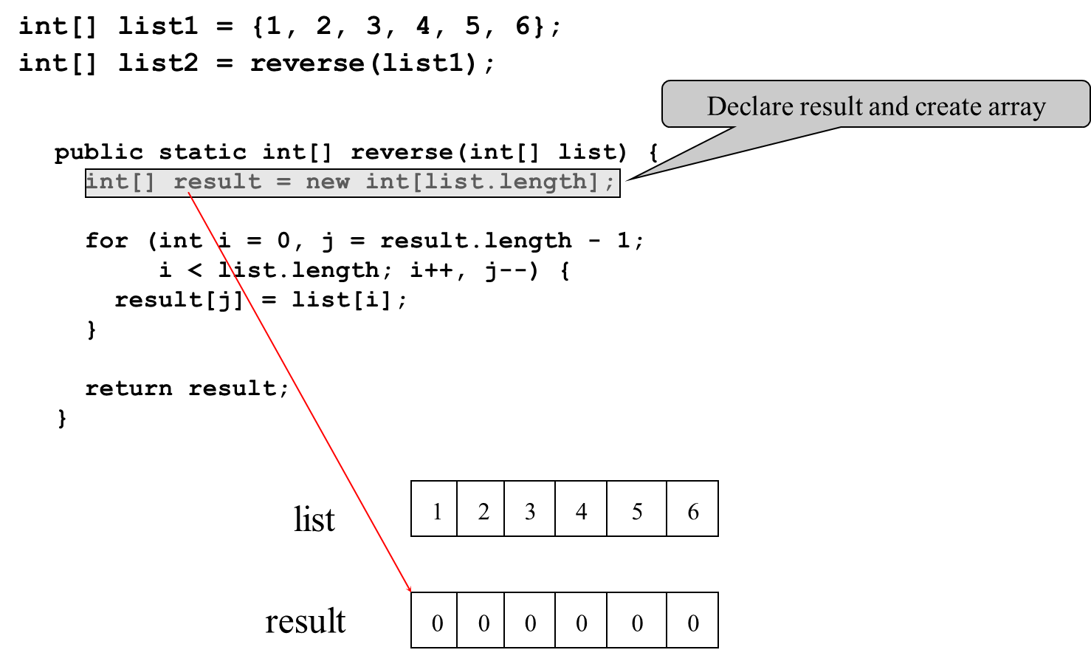
Trace the reverse Method (1 of 22)

Slide 63
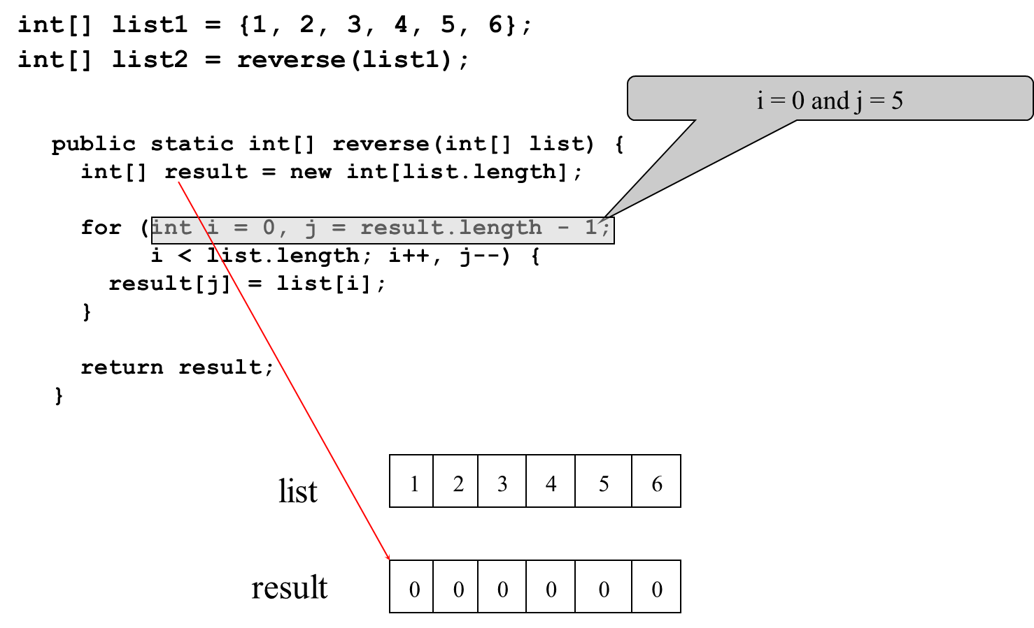
Trace the reverse Method (2 of 22)

Slide 64
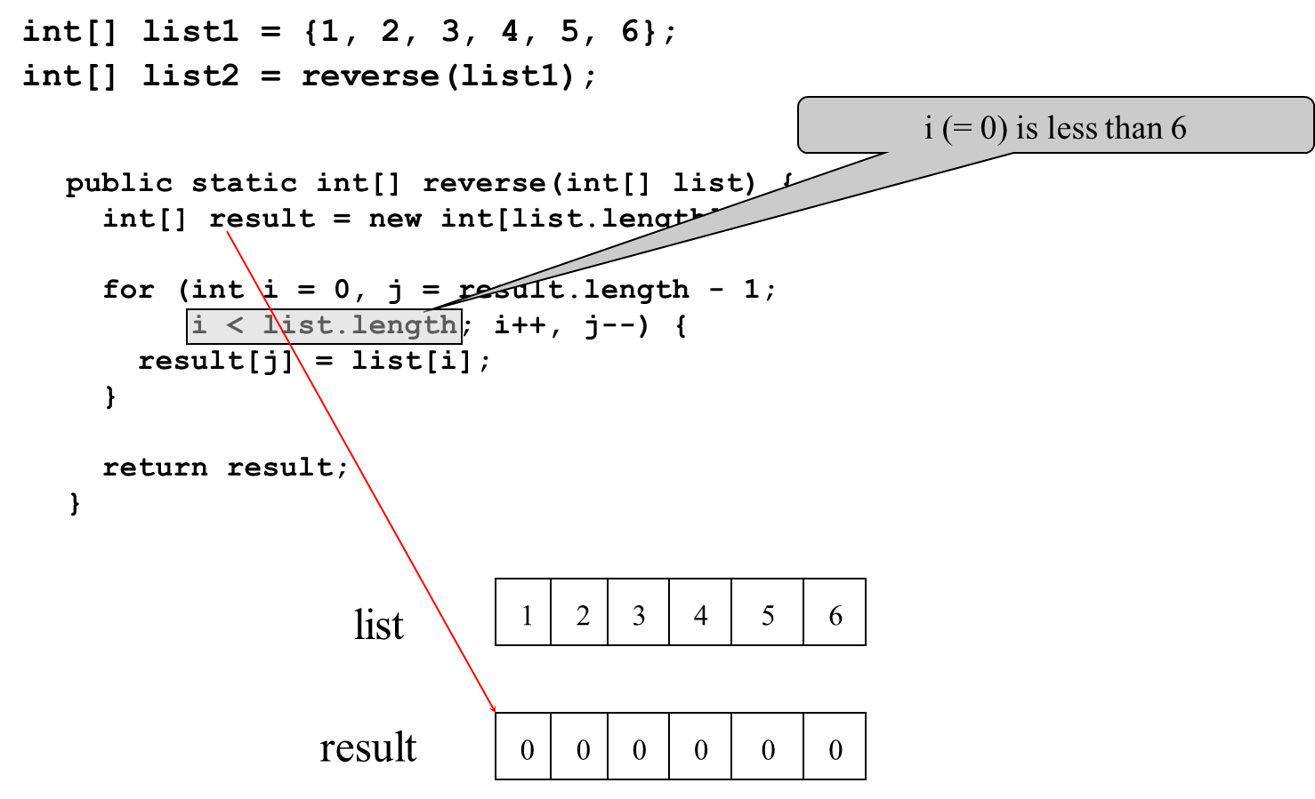
Trace the reverse Method (3 of 22)

Slide 65
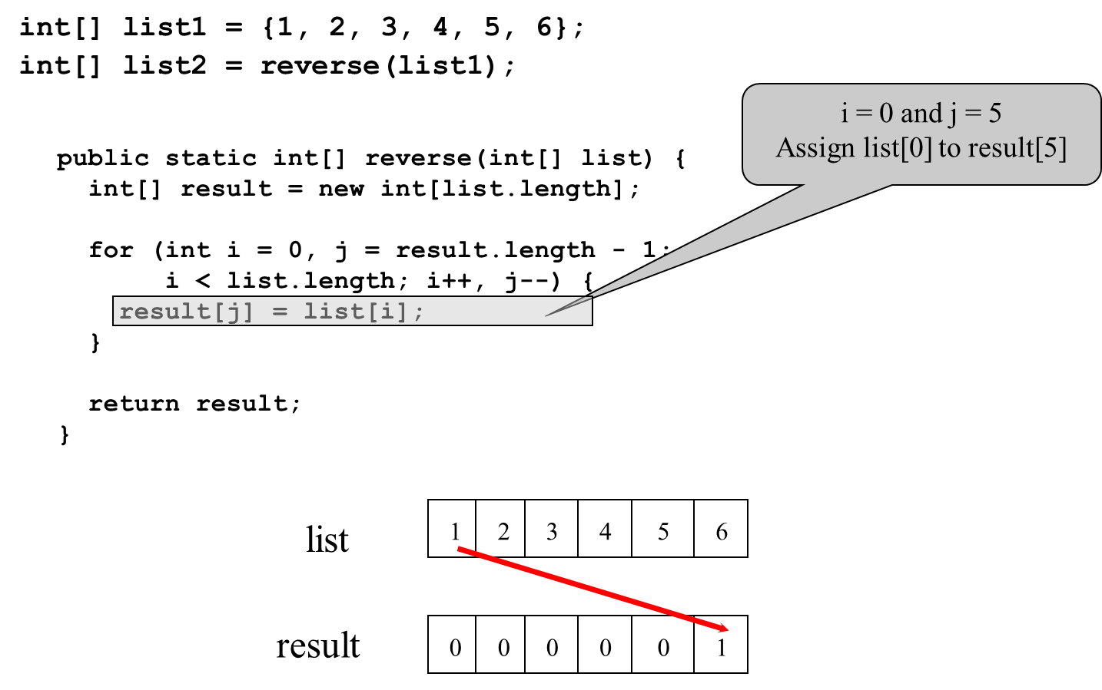
Trace the reverse Method (4 of 22)

Slide 66

Trace the reverse Method (5 of 22)

Slide 67

Trace the reverse Method (6 of 22)

Slide 68

Trace the reverse Method (7 of 22)

Slide 69

Trace the reverse Method (8 of 22)

Slide 70

Trace the reverse Method (9 of 22)

Slide 71

Trace the reverse Method (10 of 22)

Slide 72

Trace the reverse Method (11 of 22)

Slide 73

Trace the reverse Method (12 of 22)

Slide 74

Trace the reverse Method (13 of 22)

Slide 75

Trace the reverse Method (14 of 22)

Slide 76

Trace the reverse Method (15 of 22)

Slide 77

Trace the reverse Method (16 of 22)

Slide 78

Trace the reverse Method (17 of 22)

Slide 79

Trace the reverse Method (18 of 22)

Slide 80

Trace the reverse Method (19 of 22)

Slide 81

Trace the reverse Method (20 of 22)

Slide 82

Trace the reverse Method (21 of 22)

Slide 83

Trace the reverse Method (22 of 22)

Slide 84

Problem: Counting Occurrence of Each Letter
Generate 100 lowercase letters randomly and assign to an array of characters.
Count the occurrence of each letter in the array.
CountLettersInArray
Run

Slide 85
Variable-Length Arguments
You can pass a variable number of arguments of the same type to a method.
VarArgsDemo
Run

Slide 86
Searching Arrays
Searching is the process of looking for a specific element in an array; for example, discovering whether a certain score is included in a list of scores. Searching is a common task in computer programming. There are many algorithms and data structures devoted to searching. In this section, two commonly used approaches are discussed, linear search and binary search.

Slide 87
Linear Search
The linear search approach compares the key element, key, sequentially with each element in the array list. The method continues to do so until the key matches an element in the list or the list is exhausted without a match being found. If a match is made, the linear search returns the index of the element in the array that matches the key. If no match is found, the search returns -1.

Slide 88

Linear Search Animation (1 of 2)

Slide 89

Linear Search Animation (2 of 2)
Click here to see linear search animation graph

Slide 90


From Idea to Solution (1 of 2)
Trace the method

Slide 91
Binary Search (1 of 6)
For binary search to work, the elements in the array must already be ordered. Without loss of generality, assume that the array is in ascending order.
e.g., 2 4 7 10 11 45 50 59 60 66 69 70 79
The binary search first compares the key with the element in the middle of the array.

Slide 92
Binary Search (2 of 6)
Consider the following three cases:
If the key is less than the middle element, you only need to search the key in the first half of the array.
If the key is equal to the middle element, the search ends with a match.
If the key is greater than the middle element, you only need to search the key in the second half of the array.

Slide 93

Binary Search (3 of 6)

Slide 94

Binary Search Animation
Click here to see binary search animation graph

Slide 95

Binary Search (4 of 6)

Slide 96
Binary Search (5 of 6)

Slide 97
Binary Search (6 of 6)
The binarySearch method returns the index of the element in the list that matches the search key if it is contained in the list. Otherwise, it returns
-insertion point - 1.
The insertion point is the point at which the key would be inserted into the list.

Slide 98

From Idea to Solution (2 of 2)

Slide 99

The Arrays.binarySearch Method
Since binary search is frequently used in programming, Java provides several overloaded binarySearch methods for searching a key in an array of int, double, char, short, long, and float in the java.util.Arrays class. For example, the following code searches the keys in an array of numbers and an array of characters.
For the binarySearch method to work, the array must be pre-sorted in increasing order.

Slide 100
Sorting Arrays
Sorting, like searching, is also a common task in computer programming. Many different algorithms have been developed for sorting. This section introduces a simple, intuitive sorting algorithms: selection sort.

Slide 101
Selection Sort (1 of 2)
Selection sort finds the smallest number in the list and places it first. It then finds the smallest number remaining and places it second, and so on until the list contains only a single number.

Slide 102

Selection Sort (2 of 2)

Slide 103

Selection Sort Animation
Click here to see selection sort animation graph

Slide 104

From Idea to Solution (1 of 4)

Slide 105

From Idea to Solution (2 of 4)

Slide 106

From Idea to Solution (3 of 4)

Slide 107

From Idea to Solution (4 of 4)

Slide 108

Wrap it in a Method

Slide 109

The Arrays.sort Method
Since sorting is frequently used in programming, Java provides several overloaded sort methods for sorting an array of int, double, char, short, long, and float in the java.util.Arrays class. For example, the following code sorts an array of numbers and an array of characters.
Java 8 now provides Arrays.parallelSort(list) that utilizes the multicore for fast sorting.

Slide 110
The Arrays.toString(list) Method
The Arrays.toString(list) method can be used to return a string representation for the list.

Slide 111
Pass Arguments to Invoke the Main Method

Slide 112
Main Method Is Just a Regular Method
You can call a regular method by passing actual parameters. Can you pass arguments to main? Of course, yes. For example, the main method in class B is invoked by a method in A, as shown below:

Slide 113

Command-Line Parameters

Slide 114
Processing Command-Line Parameters
In the main method, get the arguments from
, which corresponds to
in the command line.

Slide 115

Problem: Calculator
Objective: Write a program that will perform binary operations on integers. The program receives three parameters: an operator and two integers.
Calculator
Run

Slide 116

Copyright

